Slide 1

Network Analysis of EU CO₂ emissions and its effect on Climate Change
Amogh Patnaik (10475877)

Slide 2
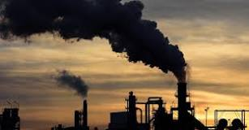

Introduction
“By polluting the oceans, not mitigating CO₂ emissions and destroying our biodiversity, we are killing our planet. Let us face it, there is no planet B.”

Slide 3
Dataset
I’ve selected the dataset covering CO2 emissions data in EU countries. I have chosen this topic since it talks about Climate Change, which is the most critical problem of our generation and for years to come.
Through my dataset and the subsequent network analysis, I’m hoping to uncover some underlying themes in the CO2 emissions data to help me understand the key factors impacting climate change in the different countries.
URL: https://datahub.io/core/eu-emissions-trading-system#readme

Slide 4
Dataset Exploration
Data | Description
country_code | Country Code
country | Country Name
main activity sector name | Activity Name
ETS information | Emissions Trading Systems Information
year | Year Name
value | Amount of CO2 emissions
unit | Tonne of CO2 equivalent

Slide 5
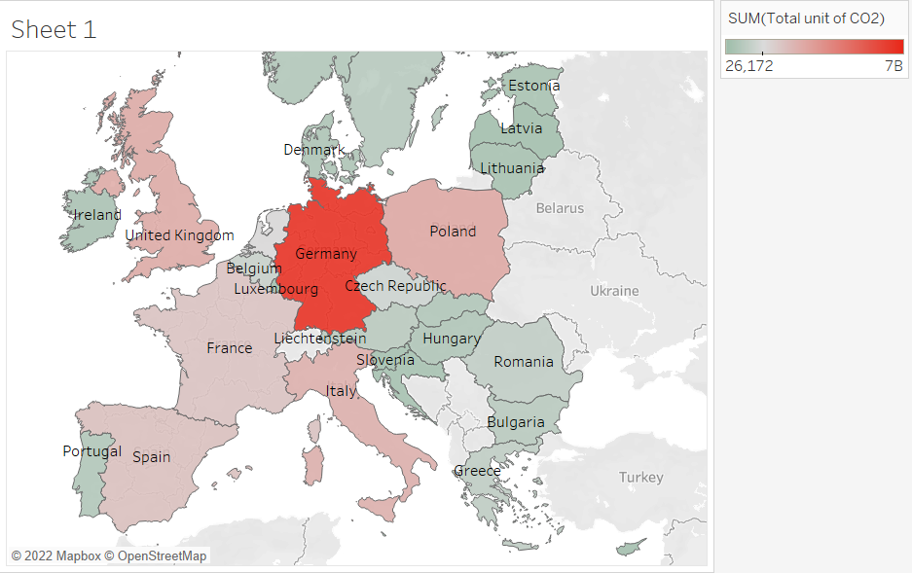
Exploratory Charts
Germany, Poland, UK, Italy, Spain are the five countries with the most notably high amount of CO2 emissions, and hence will be the focus of our network

Slide 6
Exploratory Charts
Contribution of each activity to total CO2 emissions

Slide 7
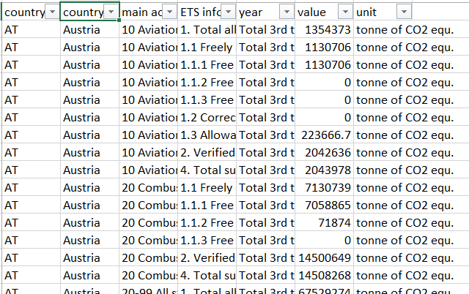
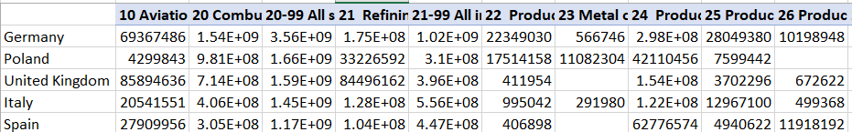
Dataset Manipulation for project
The initial dataset had over 3000 rows of data, with 32 countries and 30 activities
For the purpose of my social network analysis – I filtered out data on the following:
Year 2013-20
Top 5 countries based on total unit of CO2 equi.
Restructured the data to show activities in columns and countries in rows

Slide 8
Research Questions
1. Which EU countries are contributing the most to the CO2 emissions?
2. Which activities are contributing the most to CO2 emissions?
3. Are there any common themes between the EU countries in terms of which activities are the most influential to emission data?

Slide 9
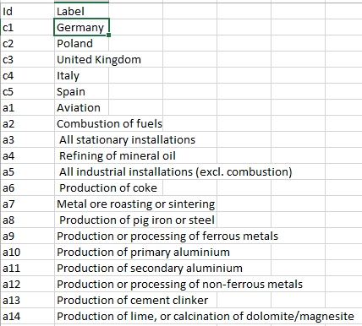
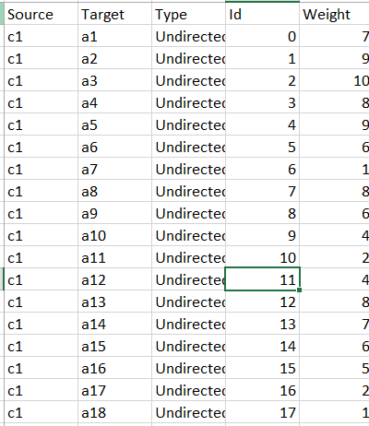
Nodes and Edges
Nodes - c1 – c5: The five countries
a1 – a30: The thirty activities
Edges – Connections between the countries and the activities, with the weight representing the tonne of CO2 equi. standardized to a 1-10 scale

Slide 10
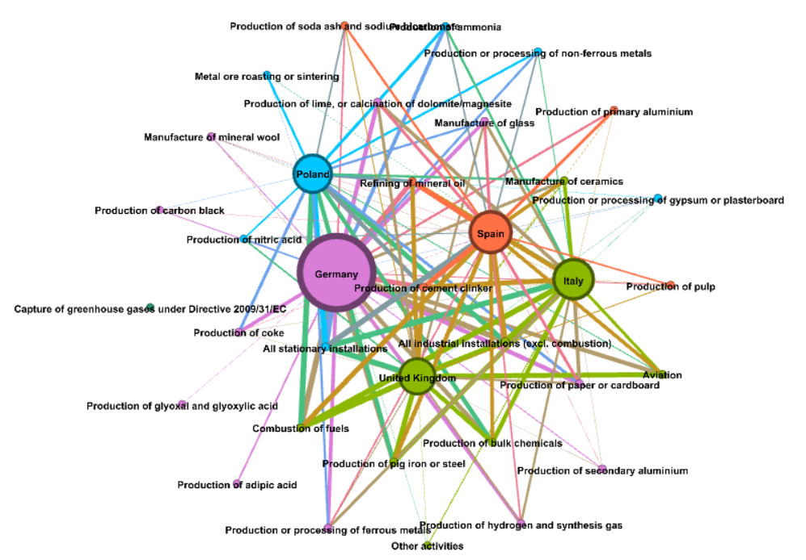
Network
Colors based on Modularity

Slide 11
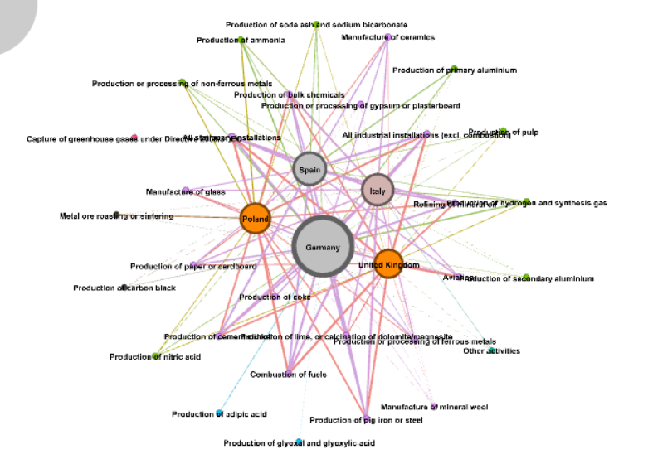
Network
Colors based on Closeness Centrality

Slide 12
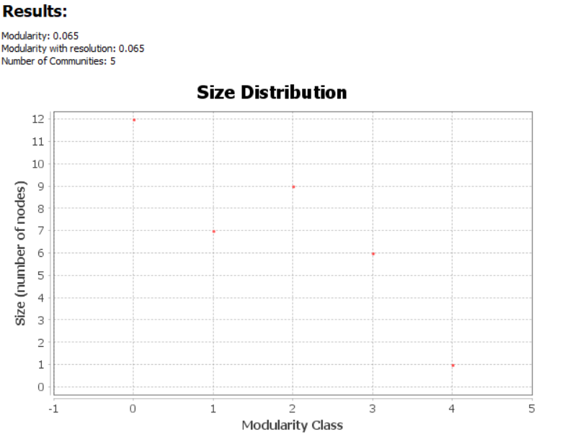
Gephi Statistics

Slide 13
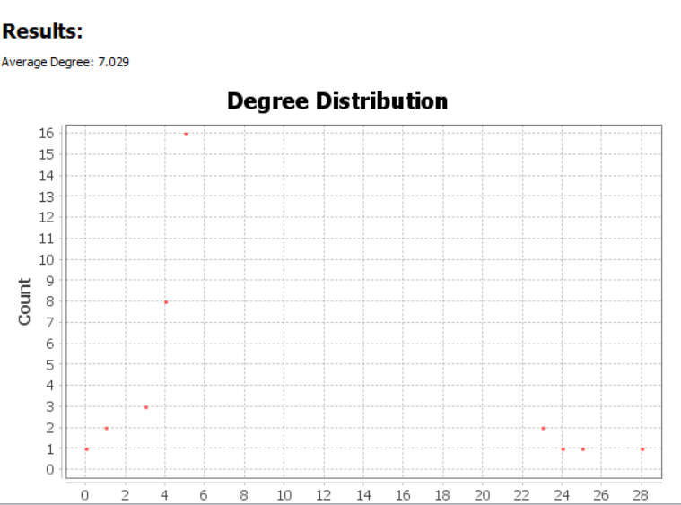
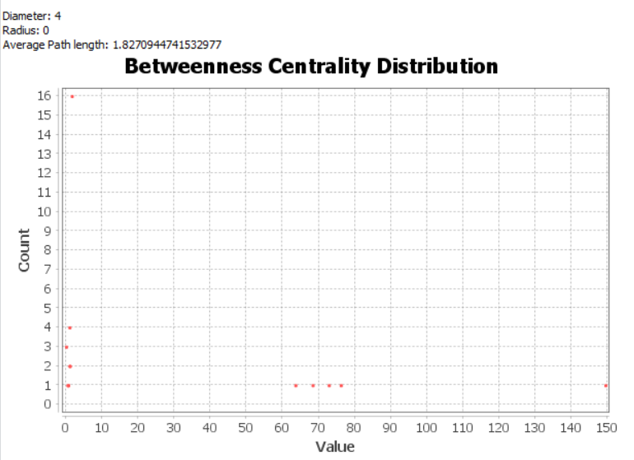
Gephi Statistics

Slide 14
Beyond SNA - Investigating the Network
What’s happening in Germany?
UK v/s Italy – what are the similarities?

Slide 15
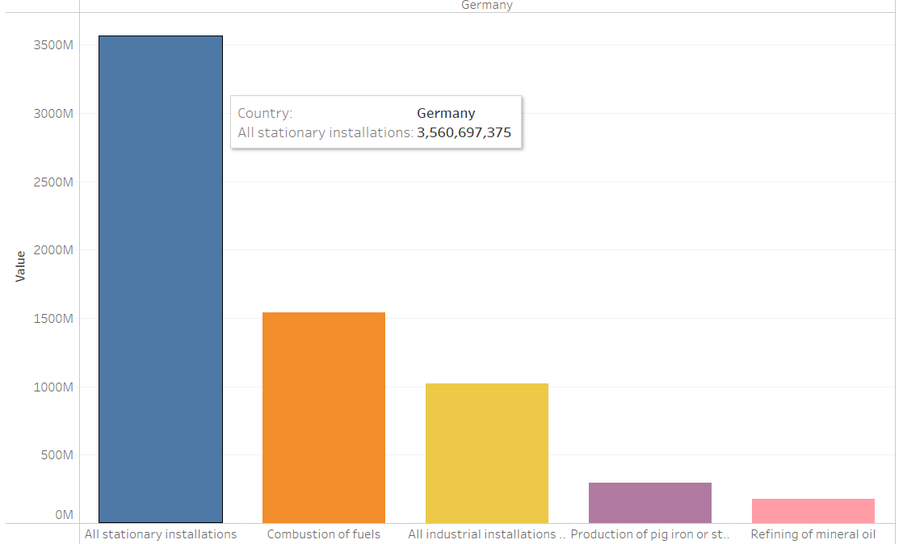
Germany – Deep-dive
5 highest contributing factors in Germany as follows
Also, ranked 1 within countries for 4 out of 5 of these activities
Industrial and transport sectors – main culprits

Slide 16
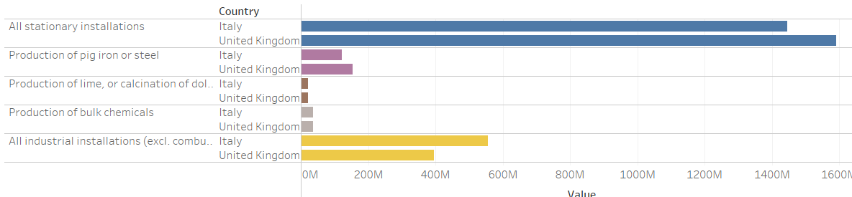
Italy v/s UK
Italy and UK pretty much mirror each other in their highest contributing activities, and fare roughly similar across each of them

Slide 17
Exploring other metrics

Slide 18
Exploring other metrics

Slide 19
Conclusion
The countries of Germany, UK, Poland, UK, Italy and Spain are suffering from the most significant CO2 emissions, while Netherlands, Belgium and Malta have the highest density of CO2 emissions
Stationary installations contribute to a majority of the CO2 emissions, followed by combustion of fuels and industrial installations
The strategy to tackle CO2 emissions should revolve around the main activities contributing to it in each country (certain countries can follow similar strategies such as Italy and UK)

Slide 20
THANK YOU!

